Slide 1

An intercomparison of two cities: Toronto, Canada and London, United Kingdom
Benjamin Allen
March 27, 2021

Slide 2
Introduction
“To what extent are the cities of Toronto and London similar to each other?” is the proposed question for the Data Science Capstone project
Whilst both cities may be classed as capital cities, the difference in history and continental divide could present stark differences in composition with respect to small businesses, and the presence of large international corporations
Furthermore, due to the difference in geographic make-up with respect to street layout, it would be interesting to see whether there are significant differences in this area.
Therefore, I propose to leverage Foursquare data to map and intercompare the composition of both respective cities in terms of business type.

Slide 3
Data
It was my intent to scrape the postcode locations from the respective cities Wikipedia entry
With regards to co-ordinate data for the post-codes, for Toronto, the co-ordinate data was obtained from the Google Maps Geocoding API
However, for our London dataset, conveniently; British Ordnance-Survey (OSBNG) National grid co-ordinates were provided for each borough.
Once processed and wrangled, I intend to cross-reference the locations of businesses in both cities with Foursquare data. Lastly, I will then cluster the results in order to determine composition.

Slide 4
Methodology
We will be creating our model utilizing the Python programming language
I. Pandas: To collect and manipulate data in JSON and HTMl and then data analysis II. Requests: Handling http requests III. NumPy – Handling array computation IV. Matrixplot Library: Detailing our generated maps V. Folium: Generating maps of London and Toronto VI. Sklearn: To import the KMeans machine learning model.
The chosen approach is to explore each of the cities individually, plot neighbourhoods being considered on a general map
Then, plot the new map with the clustered neighbourhoods, which will allow us to draw insights and compare our findings between the two cities.

Slide 5
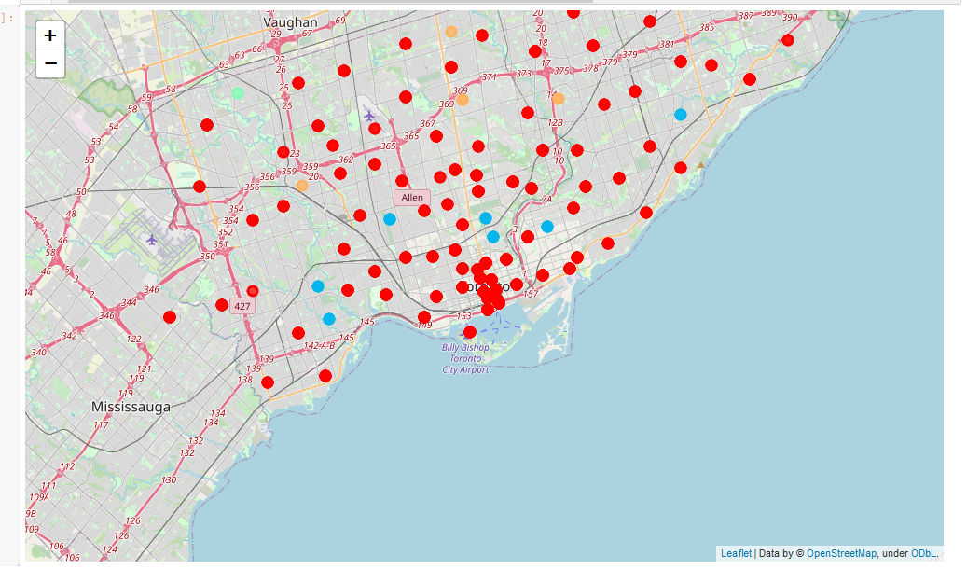
Results - Toronto
From the cluster analysis of Toronto, we can see definitive local tastes indicative of cultural favourites – most notably, the presence of large numbers of hockey arenas in the city
In the other clusters, we see the presence of large numbers of parks and open green spaces, which indicates that Canadians largely favour outdoor activities, coupled with sports.
Furthermore, as expected of a capital city; it is highly multicultural, with large numbers of Portuguese and French restaurants making appearances in the clustering results.

Slide 6
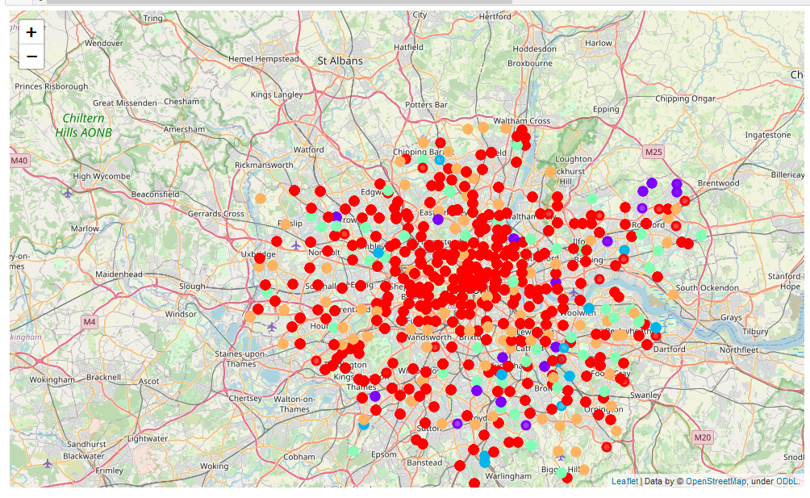
Results - London
There are numerous different cuisine options including Indian, Italian, Turkish and Chinese. Interestingly, there is a reasonable presence of African restaurants, which is understandable when considering the historical imperial context of the city
Furthermore, it has a lot of shopping options too with that of the electronics stores, flower shops, fish markets, and clothing stores
The main modes of transport seem to be buses and trains, with the clustering algorithm picking those up. For leisure, the neighbourhoods are set up to have lots of parks, gyms and historic sites.
With respect to London especially, the K-Means algorithm has located a definitive cluster of neighbourhoods towards the east and south of the city - these areas are typically home to emigratory communities, which has been interesting to see this noticed by the algorithm

Slide 7
Conclusion
The aim of this project was to explore the cities of London and Toronto and see to what extent the differences of the two cities were.
We explored both the cities based on their postal codes and then extrapolated the common venues present in each of the neighborhoods, finally concluding with clustering similar neighborhoods together.
Both cities encompass high levels of multi culturalism, whilst retaining the presence of cultural favorites – in the case of Londoners this is the presence of pubs, and in Toronto – Hockey pitches and arenas.
The ability of the K-Means algorithm to identify clusters in such densely packed cities is a testament to its capability and robustness.

